Slide 1
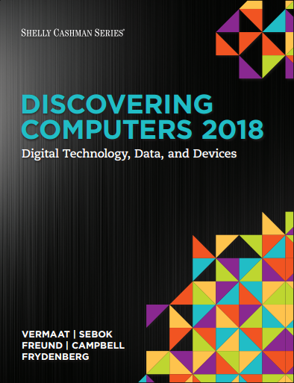

DISCOVERING COMPUTERS 2018 Digital Technology, Data, and Devices
Module 3
Computers and Mobile Devices: Evaluating Options for Home and Work
Copyright © 2018 Cengage Learning®. May not be scanned, copied or duplicated, or posted to a publicly accessible website, in whole or in part.

Slide 2
Objectives Overview (1 of 2)
Describe the characteristics and uses of laptops, tablets, desktops, and all-in-ones
Describe the characteristics and types of servers
Differentiate among POS terminals, ATMs, and self-service kiosks
Describe cloud computing and identify its uses
Describe the characteristics and uses of smartphones, digital cameras, portable and digital media players, e-book readers, and wearable devices

Slide 3
Objectives Overview (2 of 2)
Describe the characteristics of and ways to interact with game devices
Identify uses of embedded computers
Differentiate a port from a connector, identify various ports and connectors, and differentiate among Bluetooth, Wi-Fi, and NFC wireless device connections
Identify safeguards against hardware theft and vandalism and hardware failure
Discuss ways to prevent health-related injuries and disorders caused from technology use, and describe ways to design a workplace ergonomically

Slide 4
Computers and Mobile Devices
Types of computers and mobile devices include:
Laptops, tablets, and desktops
Servers and terminals
Smartphones, digital cameras, e-book readers, portable and digital media players and wearable devices
Game devices
Embedded computers

Slide 5
Mobile Computers and Desktops (1 of 7)
A mobile computer is a portable personal computer, designed so that a user easily can carry it from place to place
A personal computer (PC) is a mobile computer or desktop that can perform all of its input, processing, output, and storage activities by itself and is intended to be used by one person at a time

Slide 6
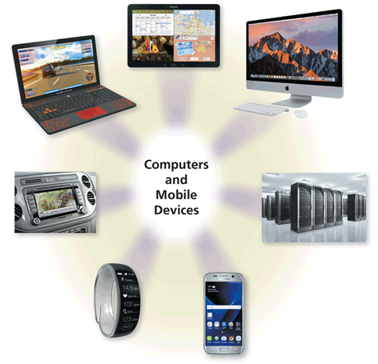
Mobile Computers and Desktops (2 of 7)
Figure 3-1 Computers and mobile devices are available in a variety of shapes and sizes.

Slide 7
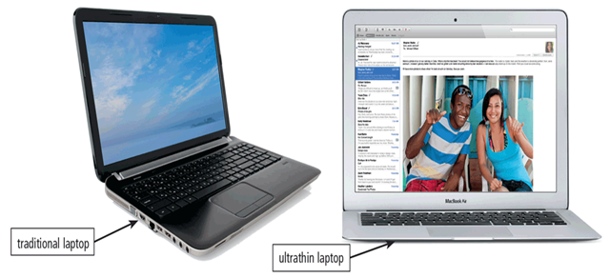
Mobile Computers and Desktops (3 of 7)
A laptop, also called a notebook computer, is a thin, lightweight mobile computer with a screen in its lid and a keyboard in its base
Figure 3-3 Traditional laptops weigh more than ultrathin laptops.

Slide 8
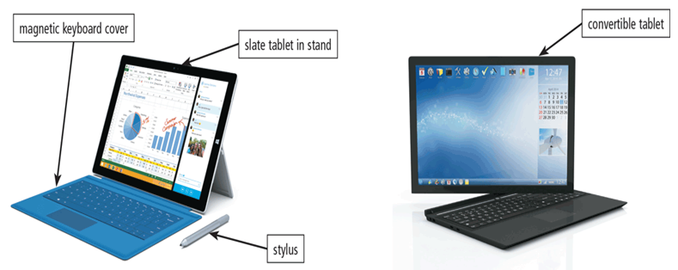
Mobile Computers and Desktops (4 of 7)
A tablet is a thin, lighter-weight mobile computer that has a touch screen
Figure 3-4 Examples of slate and convertible tablets.

Slide 9
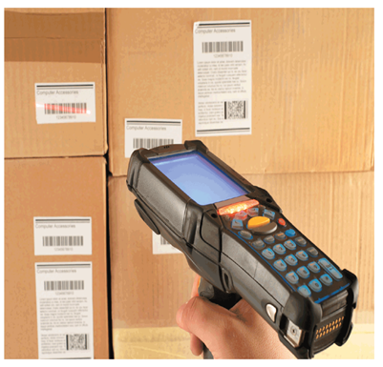
Mobile Computers and Desktops (5 of 7)
A handheld computer is a computer small enough to fit in one hand
Figure 3-6 This handheld computer is a lightweight computer that enables warehouse employees to take inventory and check supplies.

Slide 10
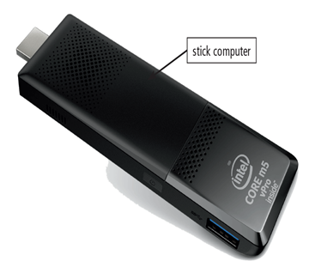
Mobile Computers and Desktops (6 of 7)
A stick computer is a small computer which usually is the same size as, or a little larger than, a USB flash drive
Figure 3-7 Stick computers are approximately the same size as USB flash drives and can connect to an HDMI port on a TV or computer monitor.

Slide 11
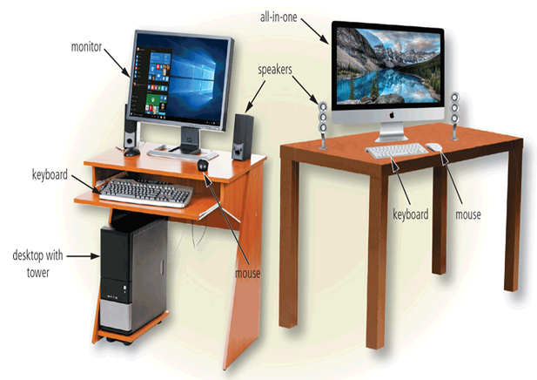
Mobile Computers and Desktops (7 of 7)
A desktop, or desktop computer, is a personal computer designed to be in a stationary location, where all of its components fit on or under a desk or table
Figure 3-8 The desktop with a tower shown in this figure is a Windows computer, and the all-in-one is a Mac computer.

Slide 12
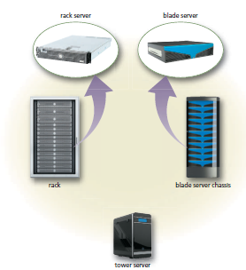
Servers (1 of 3)
A server is a computer dedicated to providing one or more services to other computers or devices on a network
Rack server
Blade server
Tower server
Figure 3-9 Shown here are a rack server, blade server, and tower server.

Slide 13
Servers (2 of 3)
Table 3-1 Dedicated Servers
Type | Main Service Provided
Application server | Stores and runs apps
Backup server | Backs up and restores files, folders, and media
Database server | Stores and provides access to a database
Domain name server | Stores domain names and their corresponding IP addresses
File server (or storage server) | Stores and manages files
FTP server | Stores files for user upload or download via FTP
Game server | Provides a central location for online gaming
Home server | Provides storage, Internet connections, or other services to computers and devices in a household
List server | Stores and manages email lists
Mail server | Stores and delivers email messages
Network server | Manages network traffic
Print server | Manages printers and documents being printed
Web server | Stores and delivers requested webpages to a computer via a browse

Slide 14
Servers (3 of 3)
Virtualization is the practice of sharing or pooling computing resources, such as servers and storage devices
Server virtualization uses software to enable a physical server to emulate the hardware and computing capabilities of one or more servers, known as virtual servers
A server farm is a network of several servers together in a single location
A mainframe is a large, expensive, powerful server that can handle hundreds or thousands of connected users simultaneously

Slide 15
Terminals (1 of 4)
A terminal is a computer, usually with limited processing power, that enables users to send data to and/or receive information from a server, or host computer
A thin client is a terminal that looks like a desktop but has limited capabilities and components
Most retail stores use a POS terminal to record purchases, process credit or debit cards, and update inventory

Slide 16
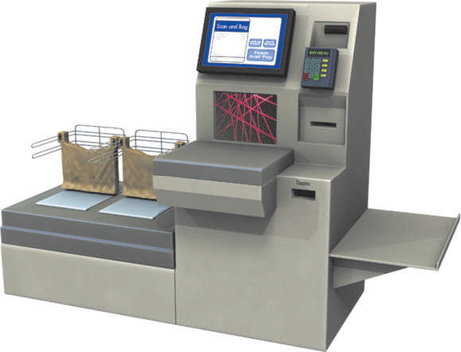
Terminals (2 of 4)
Figure 3-10 Many grocery stores offer self-service checkouts, where consumers use POS terminals to scan purchases, scan their store or saver card and coupons, and then pay for the goods.

Slide 17
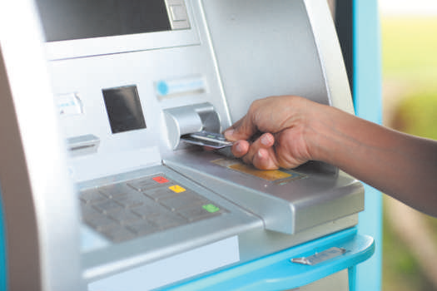
Terminals (3 of 4)
An ATM (automated teller machine) is a self-service banking terminal that connects to a host computer through a network
Figure 3-11 An ATM is a self-service banking terminal that allows customers to access their bank accounts.

Slide 18
Terminals (4 of 4)
A self-service kiosk is a freestanding terminal that usually has a touch screen for user interaction
Table 3-2 Self-Service Kiosks
Type | Typical Services Provided
Financial kiosk | Pay bills, add money to prepaid cards and phone plans, and perform other financial activities.
Photo kiosk | Print photos from digital images. Some allow editing of digital photos. Users may print directly at the kiosk or may send an order to a photo lab to be printed.
Ticket kiosk | Print tickets. Located in airports, amusement parks, movie theaters, rental companies, and train stations.
Vending kiosk | Dispense item after payment is received. Examples include DVD rentals and license plate renewals.
Visitor kiosk Manage and track visitors upon check-in. | Located in businesses, police stations, schools, hospitals, and other areas where access is controlled or registration is required.

Slide 19
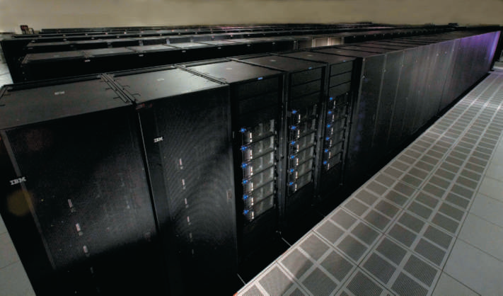
Supercomputers
A supercomputer is the fastest, most powerful computer – and the most expensive
Capable of processing many trillions of instructions in a single second
Figure 3-13 Supercomputers can process more than one quadrillion instructions in a single second.

Slide 20
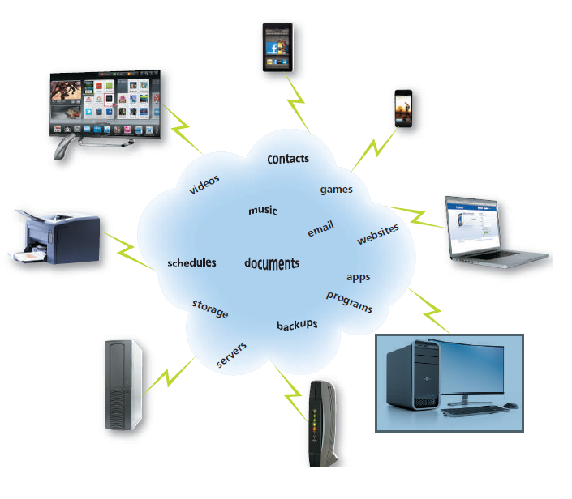
Cloud Computing
Cloud computing refers to an environment that provides resources and services accessed via the Internet
Figure 3-14 Users access resources on the cloud through their Internet connections.

Slide 21
Mobile Devices (1 of 10)
A smartphone is an Internet-capable phone that usually also includes a calendar, an address book, a calculator, a notepad, games, browser, and numerous other apps
Many smartphones have touch screens. Instead of or in addition to an on-screen keyboard, some have a built-in mini keyboard on the front of the phone or a keyboard that slides in and out from behind the phone

Slide 22
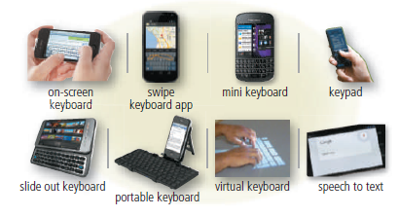
Mobile Devices (2 of 10)
Figure 3-15 A variety of options for typing on a smartphone.

Slide 23
Mobile Devices (3 of 10)
Short Message Service (SMS)
Mobile to mobile
Mobile to email
Mobile to provider
Web to mobile
Multimedia Message Service (MMS)
Mobile to mobile
Mobile to email

Slide 24
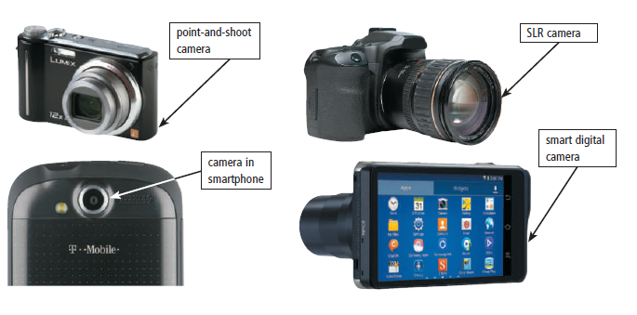
Mobile Devices (4 of 10)
A digital camera is a mobile device that allows users to take photos and store the photographed images digitally
Smart digital camera
Point-and-shoot camera
SLR camera
Figure 3-16 SLR digital cameras have lenses and other attachments, whereas the lenses on point-and-shoot cameras are built into the device. Many smartphones also have built-in digital cameras.

Slide 25
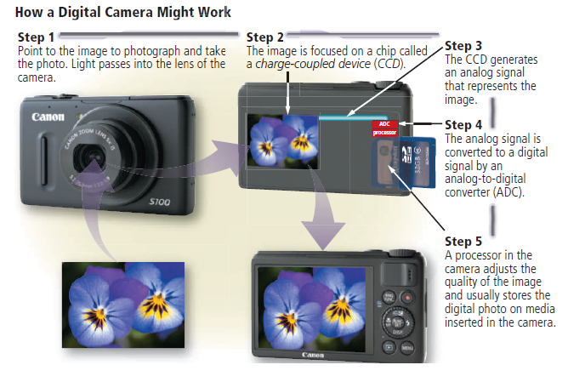
Mobile Devices (5 of 10)
Figure 3-17 This figure shows how a point-and shoot digital camera might work.

Slide 26
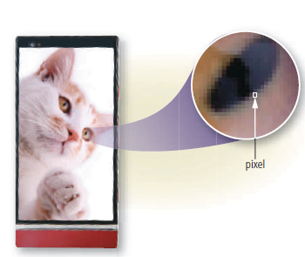
Mobile Devices (6 of 10)
Resolution is the number of horizontal and vertical pixels in a display
Figure 3-18 A pixel is the smallest element in an electronic image.

Slide 27
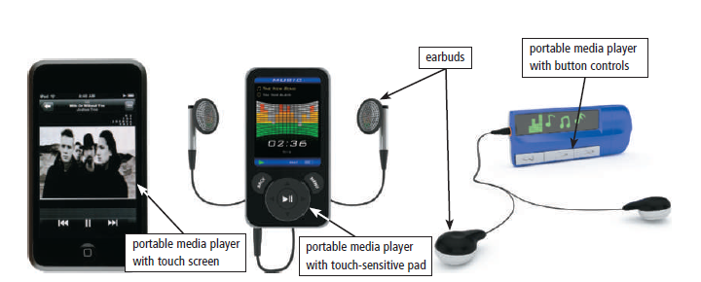
Mobile Devices (7 of 10)
A portable media player is a mobile device on which you can store, organize, and play or view digital media
Figure 3-19 Some portable media players have touch screens; others have touch-sensitive pads or buttons that enable you to access your media library.

Slide 28
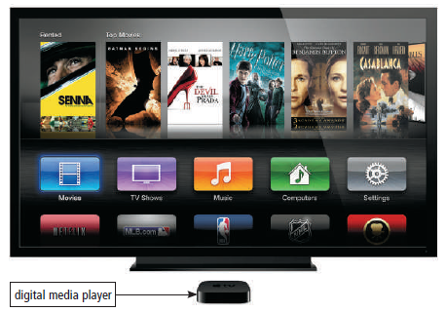
Mobile Devices ( 8 of 10)
A digital media player or streaming media player is a device, typically used in a home, that streams digital media from a computer or network to a television, projector, or some other entertainment device
Figure 3-20 A digital media player streams media to a home entertainment device.

Slide 29
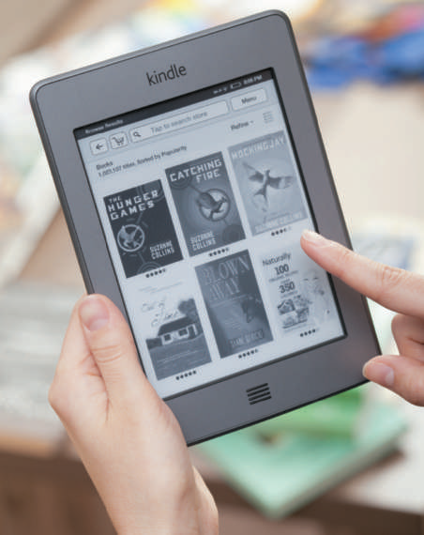
Mobile Devices ( 9 of 10)
An e-book reader (short for electronic book reader), or e-reader, is a mobile device that is used primarily for reading e-books and other digital publications
Figure 3-21 E-book readers enable you to read e-books and other digital publications such as newspapers and magazines.

Slide 30
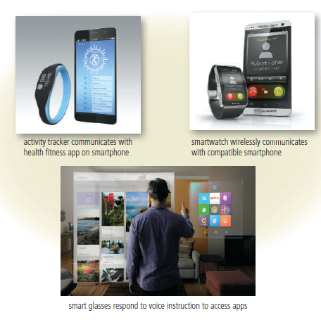
Mobile Devices ( 10 of 10)
A wearable device or wearable is a small, mobile computing device designed to be worn by a consumer
Figure 3-22 Three popular wearable devices include activity trackers, smartwatches, and smart glasses.

Slide 31
Game Devices ( 1 of 2)
A game console is a mobile computing device designed for single-player or multiplayer video games
A handheld game device is a small mobile device that contains a screen, speakers, controls, and game console all in one unit
Game controllers include gamepads, joysticks and wheels, dance pads, and a variety of motion-sensing controllers

Slide 32
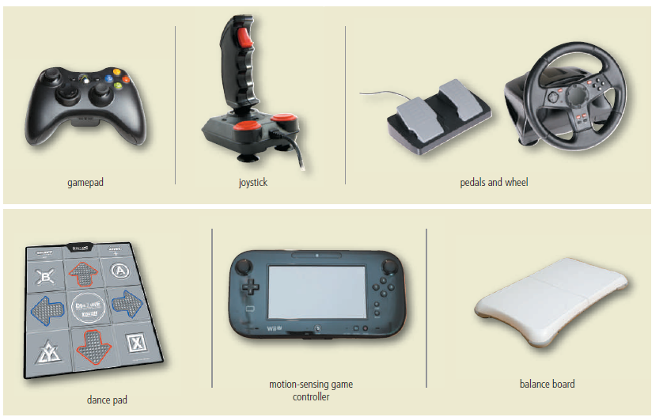
Game Devices (2 of 2)
Figure 3-23 Gamers have a variety of ways to direct movements and actions of on-screen objects.

Slide 33
Embedded Computers (1 of 2)
An embedded computer is a special-purpose computer that functions as a component in a larger product
Consumer electronics
Home automation devices
Automobiles
Process controllers and robotics
Computer devices and office machines

Slide 34
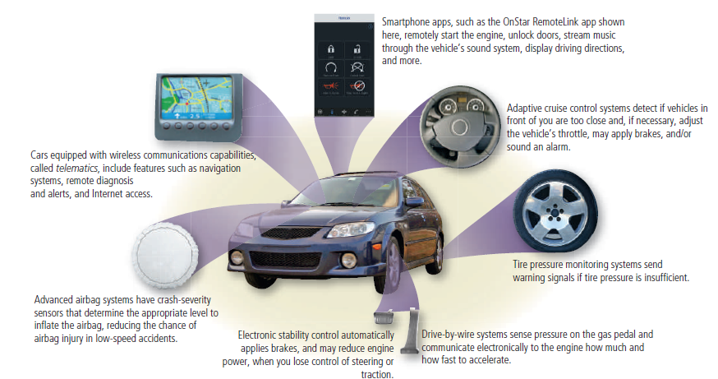
Embedded Computers (2 of 2)
Figure 3-24 Some of the embedded computers designed to improve your safety, security, and performance in today’s vehicles.

Slide 35
Putting It All Together
Table 3-3 Categories of Computers and Mobile Devices
Category | Physical Size | Number of Simultaneously Connected Users | General Price Range
Personal computers (desktop) | Fits on a desk | Usually one (can be more if networked) | Several hundred to several thousand dollars
Mobile computers and mobile devices | Fits on your lap or in your hand | Usually one | Less than a hundred dollars to several thousand dollars
Game consoles | Small box or handheld device | One to several | Several hundred dollars or less
Servers | Small cabinet to roomful of equipment | Two to thousands | Several hundred to several million dollars
Supercomputers | Full room of equipment | Hundreds to thousands | Half a million to several billion dollars
Embedded computers | Miniature | Usually one | Embedded in the price of the product

Slide 36
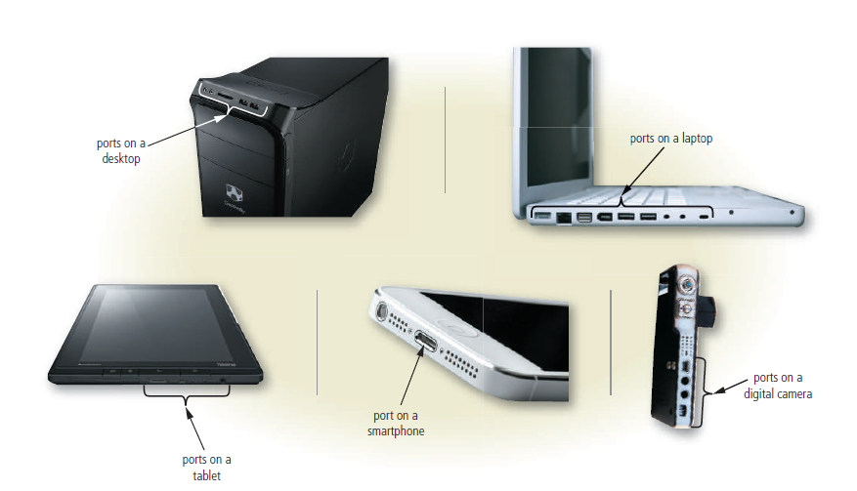
Ports and Connectors (1 of 6)
A port is the point at which a peripheral device attaches to or communicates with a computer or mobile device so that the peripheral device can send data to or receive information from the computer or mobile device
Figure 3-25 Most computers and mobile devices have ports so that you can connect the computer or device to peripherals.

Slide 37
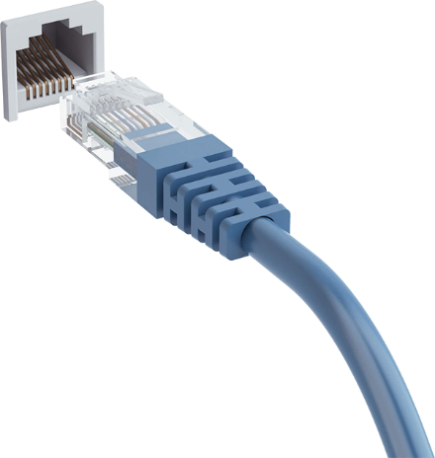
Ports and Connectors (2 of 6)
A connector joins a cable to a port
A connector at one end of a cable attaches to a port on the computer or mobile device, and a connector at the other end of the cable attaches to a port on the peripheral device
connector
port
cable

Slide 38
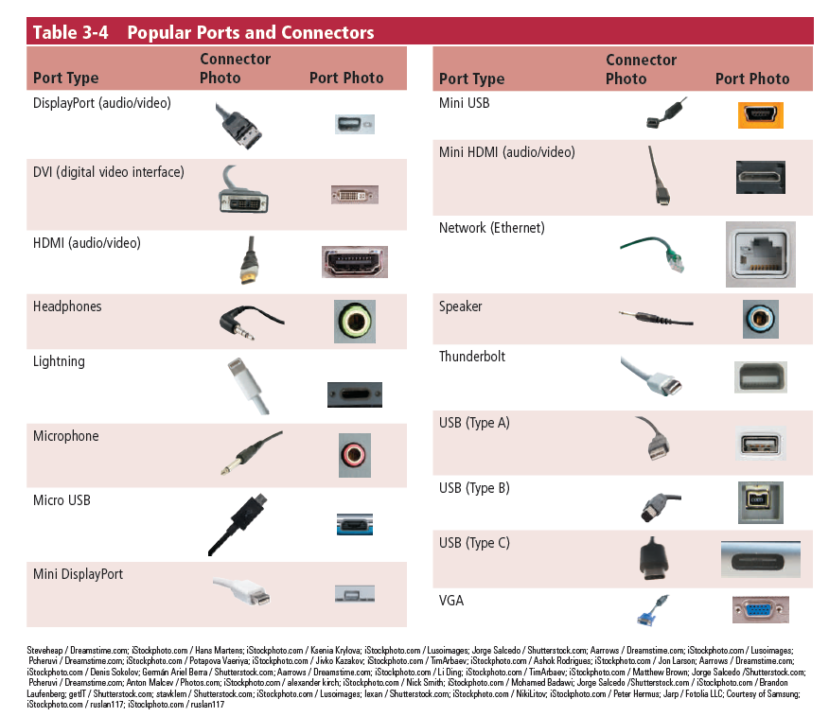
Ports and Connectors (3 of 6)

Slide 39
Ports and Connectors (4 of 6)
A USB port, short for universal serial bus port, can connect up to 127 different peripheral devices together with a single connector
Instead of connecting peripheral devices directly to ports on a mobile computer, some mobile users prefer the flexibility of port replicators and docking stations

Slide 40
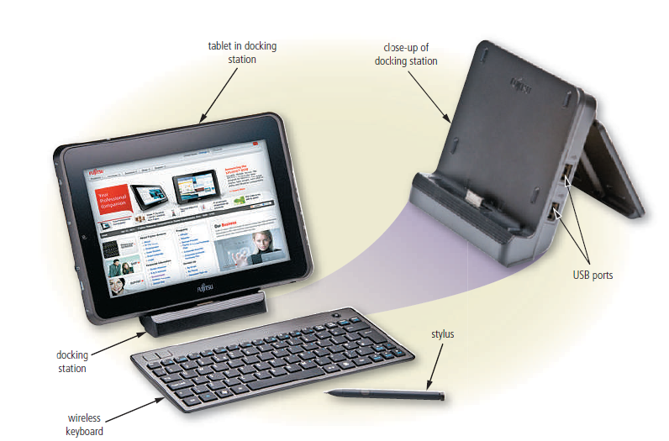
Ports and Connectors (5 of 6)
Figure 3-26 Docking stations often are used with tablets and other mobile computers, providing connections to peripheral devices.

Slide 41
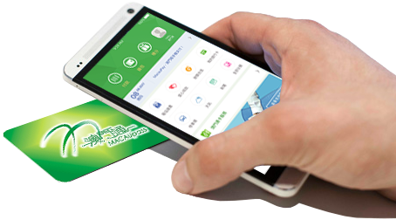
Ports and Connectors (6 of 6)
Instead of connecting computers and mobile devices to peripheral devices with a cable, some peripheral devices use wireless communications technologies
Bluetooth
Wi-Fi
NFC
An NFC card

Slide 42
Protecting Hardware (1 of 5)
To help reduce the chances of theft, companies and schools use a variety of security measures
Physical access controls
Alarm system
Physical security devices
Security or device-tracking app
Require identification

Slide 43
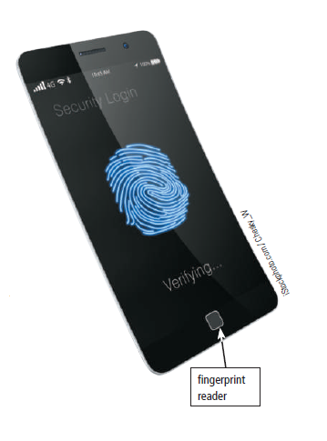
Protecting Hardware (2 of 5)
Figure 3-27 Some mobile computers and devices include fingerprint readers,
which can be used to verify a user’s identity.

Slide 44
Protecting Hardware (3 of 5)
Hardware can fail for a variety of reasons: aging hardware; random events such as electrical power problems; and even errors in programs or apps
Undervoltage
Overvoltage or power surge

Slide 45
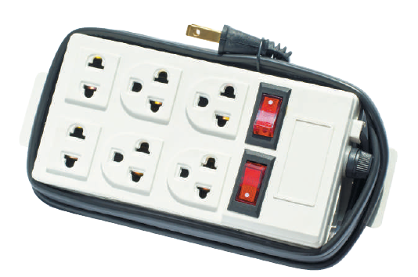
Protecting Hardware (4 of 5)
A surge protector, also called a surge suppressor, uses electrical components to provide a stable current flow and minimize the chances of an overvoltage reaching the computer and other electronic equipment
Figure 3-28 Circuits inside a surge protector safeguard against electrical power variations.

Slide 46
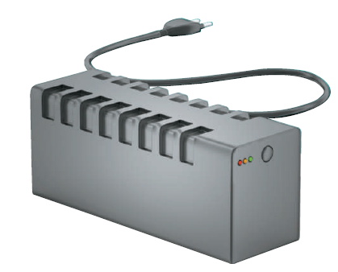
Protecting Hardware (5 of 5)
An uninterruptible power supply (UPS) is a device that contains surge protection circuits and one or more batteries that can provide power during a temporary or permanent loss of power
Figure 3-29 If power fails, a UPS uses batteries to provide electricity for a limited
amount of time.

Slide 47
Health Concerns of Using Technology (1 of 2)
A repetitive strain injury (RSI) is an injury or disorder of the muscles, nerves, tendons, ligaments, and joints
Computer vision syndrome (CVS) is a technology-related health condition that affects eyesight
Ergonomics is an applied science devoted to incorporating comfort, efficiency, and safety into the design of items in the workplace
Technology addiction occurs when the technology consumes someone’s entire social life

Slide 48
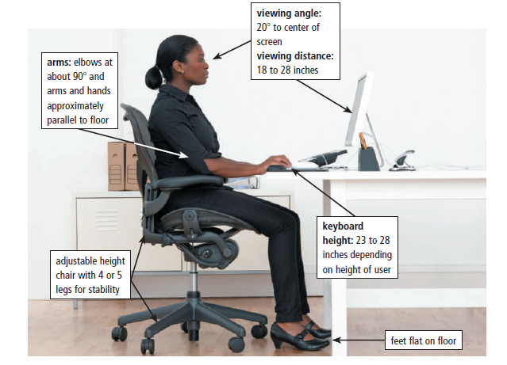
Health Concerns of Using Technology (2 of 2)
Figure 3-32 A well designed work area should be flexible to allow adjustments to the height and build of different individuals.

